Slide 1

Credit Card Customer Churn Prediction
Capstone Project
Gayathri Krishnamoorthy

Slide 2
Overview
Credit Card Customer Churn is one of the most important and challenging problems with banks. To support the bank, reduce churn rate, its crucial to predict customers that are high risk of churn. This could help the bank staffs to proactively follow up with them to turn their decision.

Slide 3
Credit Card Customer Dataset
Columns | Description
Clientnum - | Customer id number
Attrition_Flag - | Indicates Existing customer or Attired customer
Customer_Age - | Customer's age in years
Gender - | F=Female, M=Male
Dependent_count - | Number of dependent families
Education_Level: | Uneducated, High School, College, Graduate, Post-Graduate, Unknown
Marital_Status - | Married, Single, Divorced, Unknown
Income_Category: | Less than $40K, $40K - $60K, $60K - $80K, $80K - $120K, $120K +, Unknown
Card_Category: | Blue, Silver, Gold, Platinum
Months_on_book - | Months on book
Total_Relationship_Count: | Total number of products held by the customer
Contacts_Count_12_mon: | Number of contacts in the last 12 months
Months_Inactive_12_mon - | Number of months inactive in the last 12 months
Credit_Limit: | Credit limit on the credit card
Total_Revolving_Bal: | Total revolving balance on the credit card
Avg_Open_To_Buy: | Average Open- To-Buy credit line in the last 12 months
Total_Trans_Amt: | Total transaction amount in the last 12 months
Total_Ct_Chng_Q4_Q1: | Change in transaction count (Q4 over Q1)
Total_Amt_Chng_Q4_Q1: | Change in transaction amount (Q4 over Q1)
Avg_Utilization_Ratio | Average ratio of credit card balances to credit card limit.
The original dataset used in this project was from Kaggle datasets
The dataset had 10,000 customer records and 21 features
Target feature ‘Attrition_Flag’ had almost 84% of the record belonged to ‘Existing customer’ category and 16% was ‘Attired customer’

Slide 4
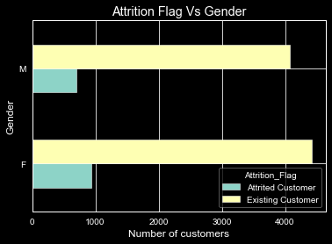
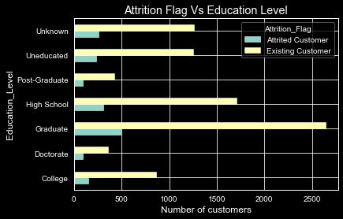
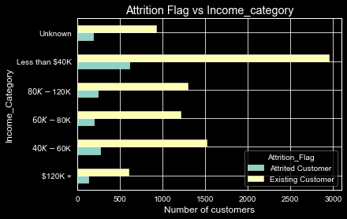
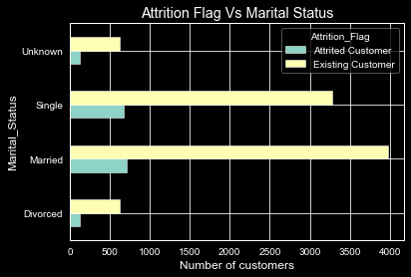
Distribution of Categorical Features
4.808927
Female customers churned more than male. Almost 9% of churned customers were female and 7% were Male
6% of Churned customers were Graduate
7% of Churned customers were in Married Category
Customers with income between 40K – 60K cancelled more.
Most of the churned customers were Blue card holders

Slide 5
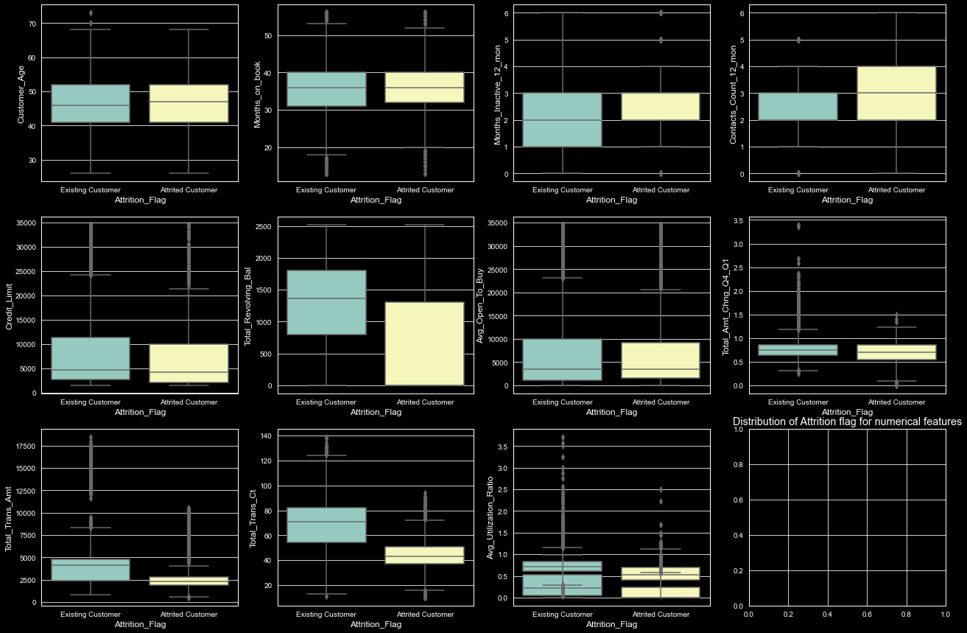
Distribution of Numerical Features
Credit_limit, Avg_open_to_buy, total_amt_change_q4toq1, total_trans_amt, utilizaiton ratio all these columns had outliers in both categories.
The contact_count_12_mon had wide range Attired customers and it was less for the existing customers.
Months on book had similar distribution for both categories.

Slide 6
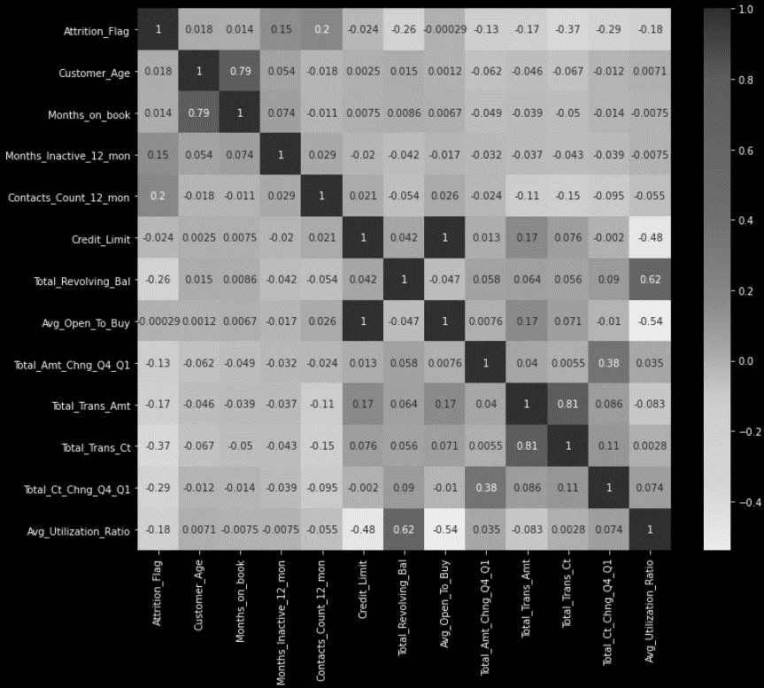
Correlation Heat Map
Attrition_Flag had reasonable corrleation with Total_trans_ct
Other variables didn’t have any reasonable correlation

Slide 7
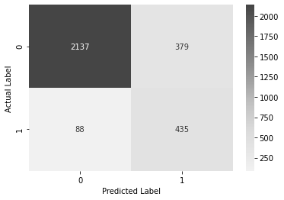
Modeling Logistic Regression Classifier -
BEST PARAMS {'C': 0.1}
Accuracy on training data: 0.87
Accuracy on test data: 0.85
precision recall f1-score support
0 0.96 0.85 0.90 2516
1 0.53 0.83 0.65 523
accuracy 0.85 3039
macro avg 0.75 0.84 0.78 3039
weighted avg 0.89 0.85 0.86 3039

Slide 8
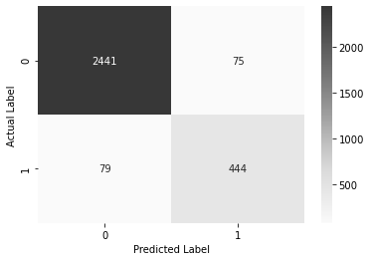
Modeling Random Forest Classifier -
BEST PARAMS {'criterion': 'gini', 'max_depth': 15, 'max_features': 'sqrt', 'n_estimators': 500}
Accuracy on training data: 1.00
Accuracy on test data: 0.95
precision recall f1-score support
0 0.97 0.97 0.97 2516
1 0.86 0.85 0.85 523
accuracy 0.95 3039
macro avg 0.91 0.91 0.91 3039
weighted avg 0.95 0.95 0.95 3039

Slide 9
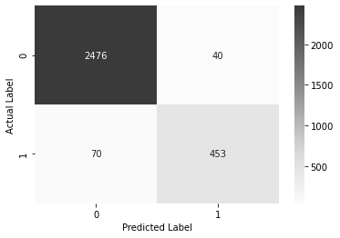
Modeling Gradient Boosting Classifier -
BEST PARAMS{'learning_rate': 0.5, 'max_depth': 11, 'max_features': 'log2', 'n_estimators': 100}
Accuracy on training data: 1.00
Accuracy on test data: 0.96
precision recall f1-score support
0 0.97 0.98 0.98 2516
1 0.92 0.87 0.89 523
accuracy 0.96 3039
macro avg 0.95 0.93 0.94 3039
weighted avg 0.96 0.96 0.96 3039

Slide 10

Modeling XGBoost Classifier -
BEST PARAMS{'colsample_bytree': 1, 'learning_rate': 0.05, 'max_depth': 7, 'n_estimators': 150, 'reg_alpha': 0.01}
Accuracy on training data: 1.00
Accuracy on test data: 0.97
precision recall f1-score support
0 0.98 0.98 0.98 2516
1 0.90 0.90 0.90 523
accuracy 0.97 3039
macro avg 0.94 0.94 0.94 3039
weighted avg 0.97 0.97 0.97 3039

Slide 11
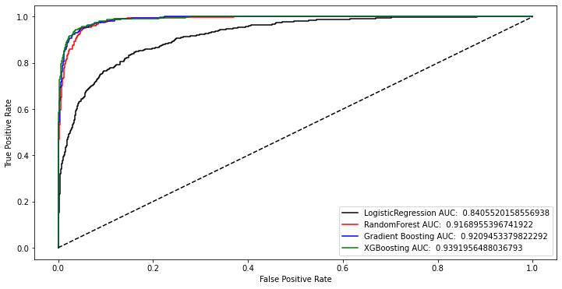
Model Comparison
The AUC score of 3 out of 4 model were above .91 as they have similar performance in predicting 0 and 1.
The XGBoost classifier had the best performance with AUC score of almost .94.

Slide 12
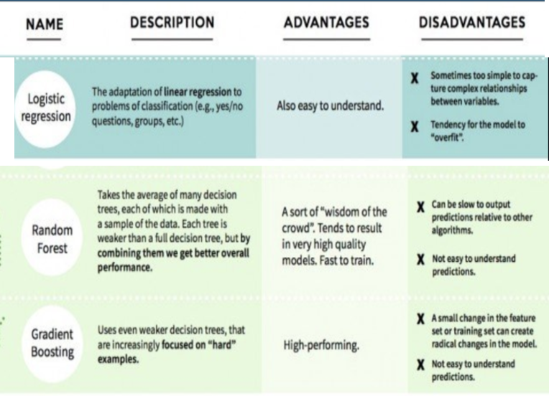
Model Comparison
Classifiers | Accuracy | AUC
LogisticRegression | 84.63 | 0.840552
RandomForest | 95.39 | 0.916896
GradientBoosting | 96.31 | 0.920945
XGBoost | 96.58 | 0.939196
XG Boost was a good option for imbalanced datasets compared to other classifiers.
XGBoost performs well with smaller datasets
XGBoost classifer had the AUC score .94

Slide 13
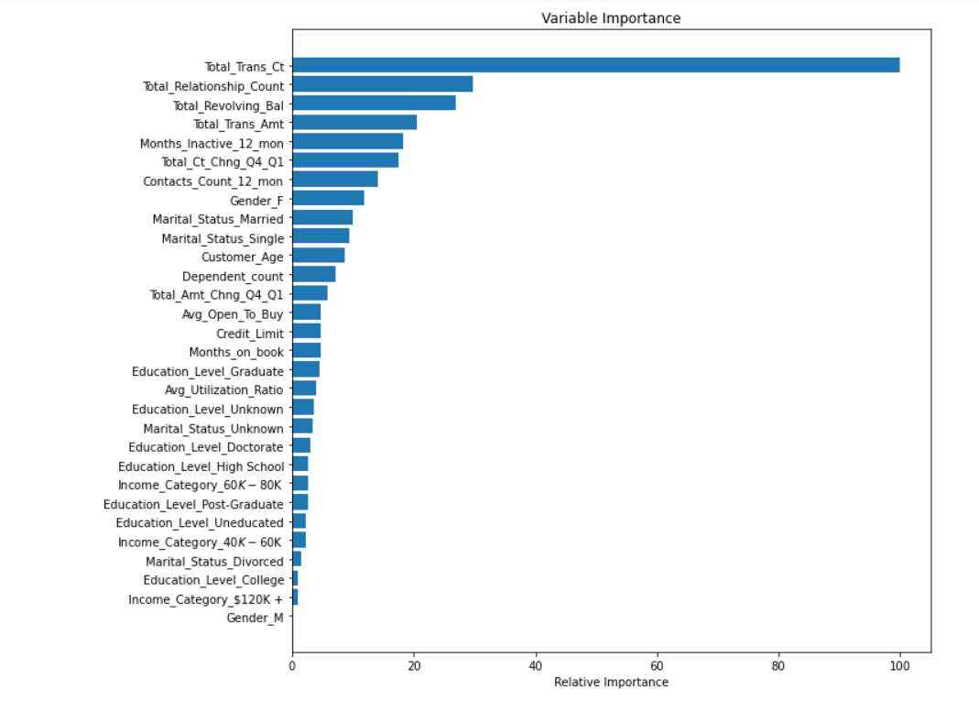
Feature Importance
The total_Trans_ct almost contibuted 100% and Total_relationship_count, Total_trans_Amt was close to 40% in classifying the customers

Slide 14
Conclusion
The Total_tran_ct was one of important feature from all the models. If a customer had not transacted in while with less total_trans_ct are more likely to chrun.
Total_relationship_count was another important variable.
It would be important tp proactively reach out to those customers to improve a personalize customer experience.
Bank could collect more information about the customers as how long they are with the service
Collect data based on satisfaction survey about credit services

